Slide 1




NEXT GEN EMPLOYABILITY PROGRAM
Creating a future-ready workforce
Team Members
College Name
Student Name : Giftsy P
Student ID : 620221104311
Annai Mathammal Sheela
Engineering College(6202)

Slide 2

CAPSTONE PROJECT SHOWCASE
Project Title
Notes Sharing Web Application using Django Framework
Abstract | Problem Statement | Project Overview | Proposed Solution | Technology Used | Modelling & Results | Conclusion

Slide 3
Abstract
Traveling is a large growing business across all countries. Bus reservation system deals with maintenance of records of details of each passenger. It also includes maintenance of information like schedule and details of each bus. We observed the working of the Bus reservation system and after going through it, we get to know that there are many operations, which they have to do manually. It takes a lot of time and causing many errors while data entry. Due to this, sometimes a lot of problems occur and they were facing many disputes with customers. To solve the above problem, and further maintaining records of passenger details, seat availability, price per seat, bill generation and other things, we are offering this proposal of computerized reservation system.
Source :

Slide 4
Problem Statement
Bus Schedule Management: Enable bus operators to manage their schedules, including adding, editing, and removing routes, as well as updating departure times and ticket prices.
Seat Availability and Booking: Provide users with real-time information on seat availability for different routes and allow them to book tickets conveniently.
Seat Selection: Allow users to select their preferred seats from an interactive seating layout.
Payment Integration: Integrate secure payment gateways to facilitate online transactions for ticket purchases.
Source :

Slide 5
Project Overview
List of functionalities the system will offer, including:
User registration and login.
Bus route search and selection.
Seat selection and reservation.
Payment processing.
Booking management for both users and administrators.
Real-time updates on bus schedules and availability.
Feedback and rating system for users
Source :

Slide 6
Proposed Solution
User Interface: Develop a user-friendly interface for customers to search for available buses, view schedules, select seats, and make reservations. This could be a web application, mobile app, or both.
Database Management: Set up a database to store information about buses, routes, schedules, available seats, and customer reservations. This database would need to be efficiently designed to handle large amounts of data and frequent updates.
Reservation Algorithm: Implement an algorithm to manage seat reservations, ensuring that seats are allocated efficiently while maximizing occupancy and minimizing conflicts.
Payment Integration: Integrate a secure payment gateway to allow customers to pay for their reservations online. This would involve handling payment processing and ensuring compliance with relevant security standards.
.
Source :

Slide 7
4.Admin Panel: Create an administrative panel for bus operators to manage routes, schedules, pricing, and seat availability. This panel would also provide tools for generating reports and analyzing performance.
5.Notifications: Implement a system to send notifications to customers regarding their reservations, including booking confirmations, reminders, and updates on schedule changes or cancellations.
6.Security Measures: Implement robust security measures to protect customer data, payment information, and the integrity of the reservation system against potential threats such as hacking or fraud.
Source :

Slide 8
C
7.Feedback Mechanism: Include a feedback mechanism for customers to provide reviews and ratings, which can help improve service quality and identify areas for enhancement.
8.Scalability: Design the system to be scalable, capable of handling increased demand during peak periods without sacrificing performance or reliability.
9.Integration with Other Systems: Consider integrating the bus reservation system with other transportation systems or services, such as hotel bookings or car rentals, to provide a seamless travel experience for customers.
Source :

Slide 9


Technology Used
Front-end
Back-end
Source :

Slide 10
Modelling & Results
Bus:
bus_id (Primary Key)
bus_name
capacity
route_id (Foreign Key)
Passenger:
passenger_id (Primary Key)
name
email
phone
Reservation:
reservation_id (Primary Key)
passenger_id (Foreign Key)
bus_id (Foreign Key)
seat_number
reservation_date
status (e.g., confirmed, pending, cancelled)
Route:
route_id (Primary Key)
origin
destination
distance
duration
fare
Source :

Slide 11
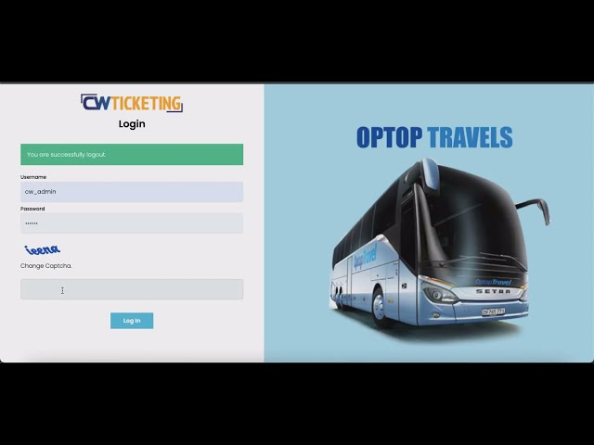
Homepage

Slide 12
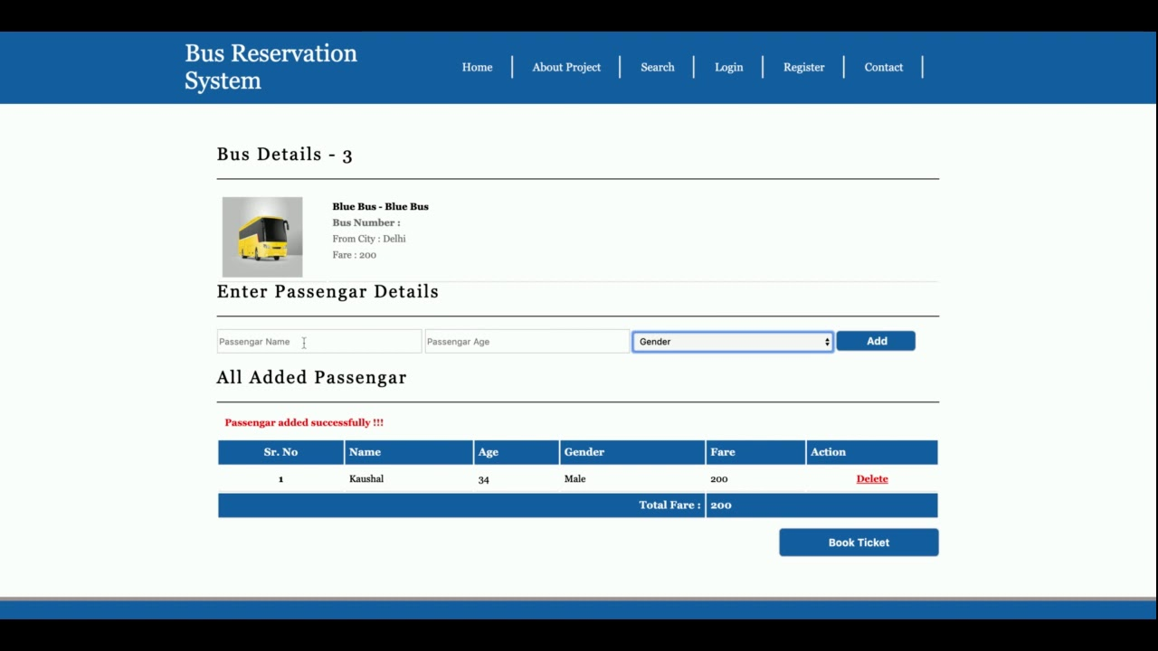
About-Us-Page

Slide 13
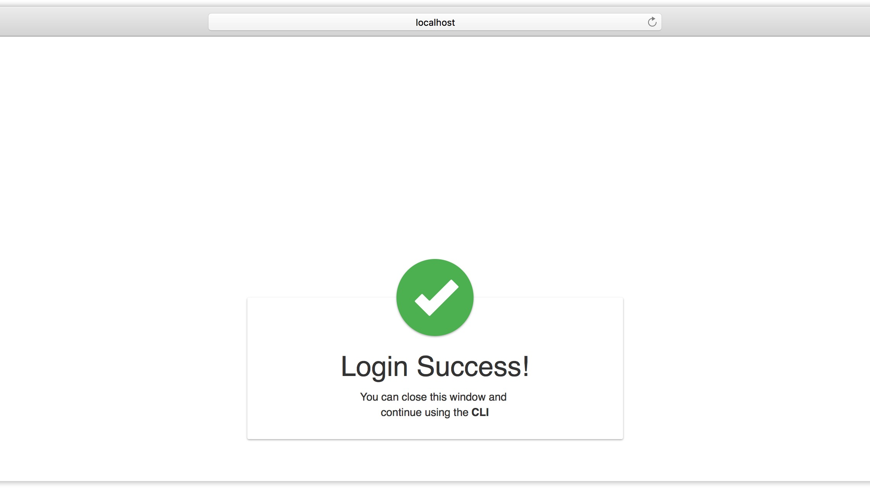
Service-Page

Slide 14
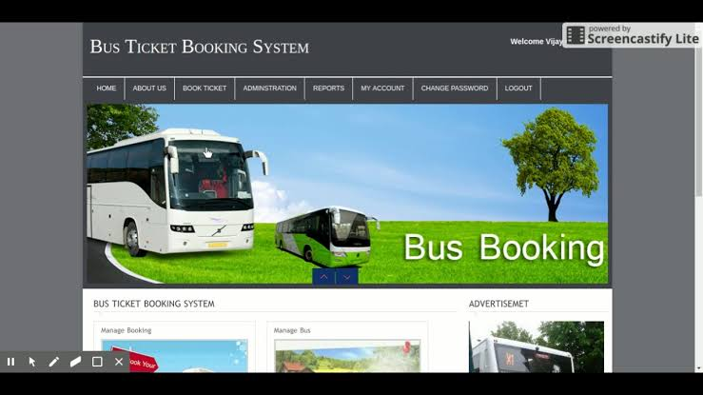
Departments-Page

Slide 15
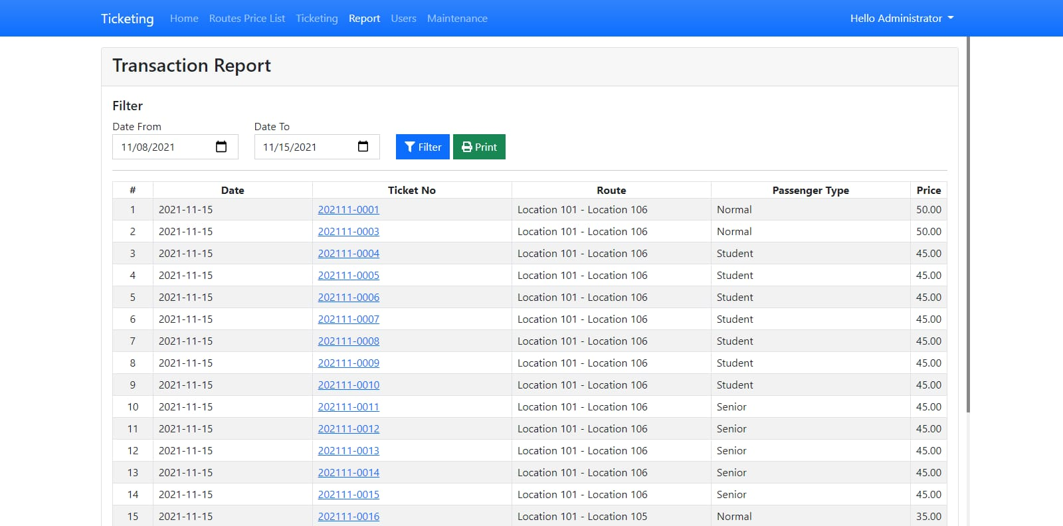
Blog-Page

Slide 16
Future Enhancements:
Real-Time Tracking: Integrate GPS tracking to provide real-time updates on bus location to passengers and administrators.
Dynamic Pricing: Implement dynamic pricing based on factors such as demand, time of booking, and seat availability.
Mobile App: Develop a mobile app for both Android and iOS platforms to allow users to easily book tickets and track their journey.
Multiple Payment Gateways: Offer a variety of payment options such as credit/debit cards, net banking, and digital wallets to enhance user convenience.
Seat Selection: Allow passengers to select their preferred seats during the booking process, with a visual representation of the bus layout.
Feedback System: Incorporate a feedback system for passengers to rate their experience and provide comments, which can help improve service quality.

Slide 17
Conclusion
The bus reservation system provides a convenient and efficient way for customers to book their bus tickets online, streamlining the booking process and enhancing customer satisfaction. With features such as seat selection, payment options, and booking management, it offers a seamless experience for both customers and bus operators. Overall, the system aims to improve accessibility, convenience, and reliability in the bus transportation industry
Source :

Slide 18
Thank You!
Notes:
Thank You !!

